Slide 1
Expression of Interest:
Proposal to search for
Heavy Neutral Leptons at the SPS
(CERN-SPSC-2013-024 / SPSC-EOI-010)
On behalf of:

Slide 2
Theoretical motivation
Discovery of the 126 GeV Higgs boson → Triumph of the Standard Model
The SM may work successfully up to Planck scale !
SM is unable to explain:
- Neutrino masses
- Excess of matter over antimatter in the Universe
- The nature of non-baryonic Dark Matter
All three issues can be solved by adding three new fundamental fermions,
right-handed Majorana Heavy Neutral Leptons (HNL): N₁, N₂ and N₃
νMSM: T.Asaka, M.Shaposhnikov PL B620 (2005) 17

Slide 3
Masses and couplings of HNLs
N₁ can be sufficiently stable to be a DM candidate, M(N₁)~10keV
M(N₂) ≈ M(N₃) ~ a few GeV→ CPV can be increased dramatically to explain
Baryon Asymmetry of the Universe (BAU)
Very weak N_{2,3}-to-ν mixing (~ U²) → N_{2,3} are much longer-lived than the SM particles
Example:
N_{2,3} production in charm
and subsequent
decays
Typical lifetimes > 10 μs for M(N_{2,3}) ~ 1 GeV
Decay distance O(km)
Typical BRs (depending on the flavour mixing):
Br(N → μ/e π ) ~ 0.1 – 50%
Br(N → μ⁻/e⁻ ρ⁺) ~ 0.5 – 20%
Br(N → νμe) ~ 1 – 10%

Slide 4
Experimental and cosmological constraints
Recent progress in cosmology
- The sensitivity of previous experiments did not probe the interesting
region for HNL masses above the kaon mass
Strong motivation to explore cosmologically allowed parameter space
Proposal for a new experiment at the SPS to search for
New Particles produced in charm decays

Slide 5
Experimental requirements
Search for HNL in Heavy Flavour decays
Beam dump experiment at the SPS with a total of 2×10²⁰ protons
on target (pot) to produce large number of charm mesons
HNLs produced in charm decays have significant P_{T}
HNL polar angle
Polar angle of μ
from N→μπ
Detector must be placed close to the target to maximize
geometrical acceptance
Effective (and “short”) muon shield is essential to reduce
muon-induced backgrounds (mainly from short-lived resonances
accompanying charm production)

Slide 6
Secondary beam-line
Proton target
- Preference for relatively slow beam extraction O(s)
to reduce detector occupancy
- Sufficiently long target made of dense material (50 cm of W) to reduce
the flux of active neutrinos produced mainly in π and K decays
- No requirement to have a small beam spot

Slide 7
Secondary beam-line (cont.)
Muon shield
Main sources of the muon flux
( estimated using PYTHIA with 10⁹
protons of 400 GeV energy )
A muon shield made of ~55 m
W(U) should stop muons with
energies up to 400 GeV
Cross-checked with results from
CHARM beam-dump experiment
Detailed simulations will
define the exact length
and radial extent of the shield
Assume that muon induced backgrounds will be
reduced to negligible level with such a shield

Slide 8
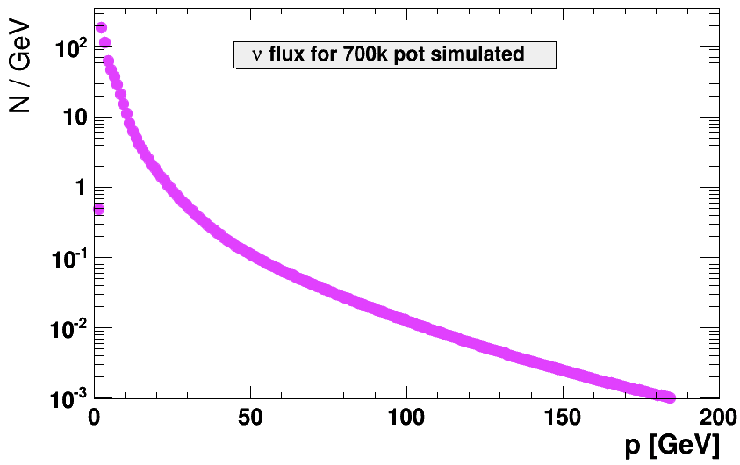
Experimental requirements (cont.)
Minimize background from interactions of active neutrinos
in the detector decay volume
Requires evacuation of the detector volume
Momentum spectrum of the
neutrino flux after the muon shield
2×10⁴ neutrino interactions per 2×10²⁰ pot in the decay volume at atmospheric pressure → becomes negligible at 0.01 mbar

Slide 9
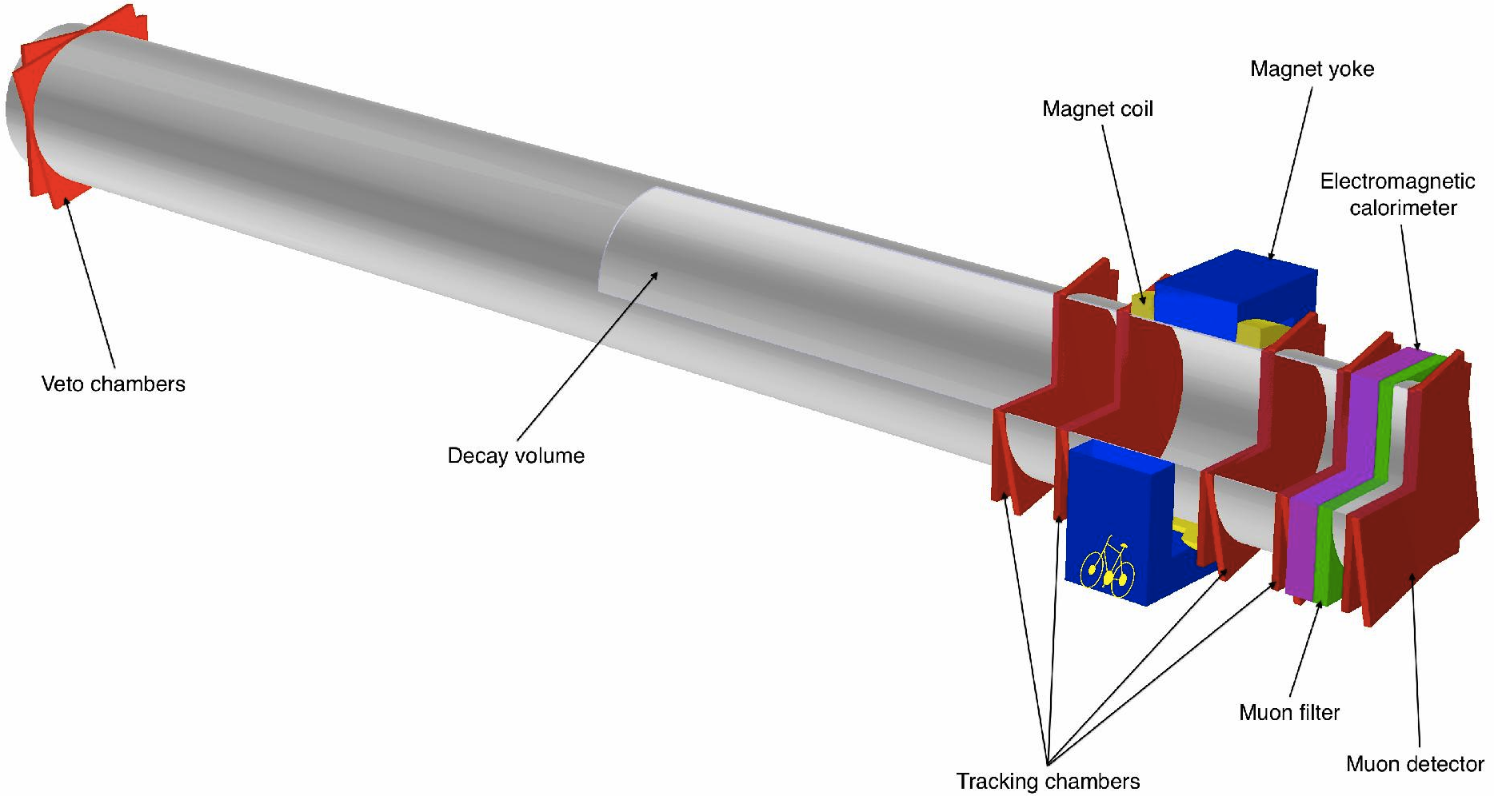
Detector concept
Reconstruction of the HNL decays in the final states: μ⁻π⁺, μ−ρ⁺ & e⁻ ρ⁺
Requires long decay volume, magnetic spectrometer, muon detector
and electromagnetic calorimeter, preferably in surface building
HNL
π⁺
Long vacuum vessel, 5 m diameter, 50 m length
10 m long magnetic spectrometer with 0.5 Tm
dipole magnet and 4 low material tracking chambers
μ⁻

Slide 10
Detector concept (cont.)
Geometrical acceptance
Saturates for a given HNL lifetime as a
function of detector length
The use of two magnetic spectrometers
increases the acceptance by 70%
Detector has two almost identical elements
Arbitrary units

Slide 11
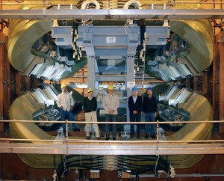
Detector apparatus
based on existing technologies
LHCb diplole magnet
Experiment requires a dipole magnet
similar to LHCb design, but with ~40%
less iron and three times less dissipated
power
Free aperture of ~ 16 m² and field
integral of ~ 0.5 Tm
- Yoke outer dimension: 8.0×7.5×2.5 m³
- Two Al-99.7 coils
- Peak field ~ 0.2 T
- Field integral ~ 0.5 Tm over 5 m length
Courtesy of W. Flegel

Slide 12
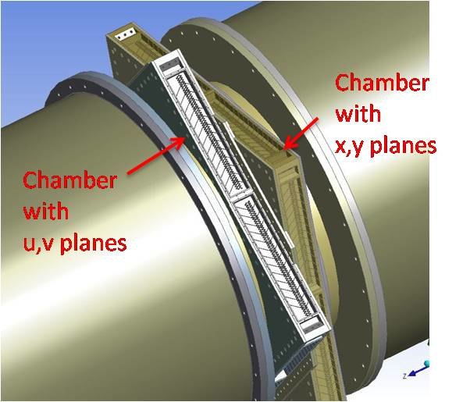
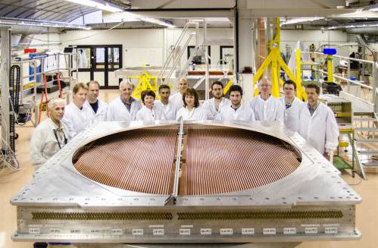
Detector apparatus (cont.)
based on existing technologies
NA62 vacuum tank and straw tracker
< 10⁻⁵ mbar pressure in NA62 tank
Straw tubes with 120 μm spatial resolution and 0.5% X₀/X material budget
Gas tightness of NA62 straw tubes demonstrated in long term tests
NA62 straws

Slide 13
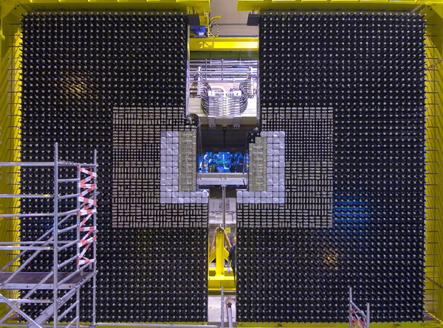
Detector apparatus (cont.)
based on existing technologies
LHCb ECAL
LHCb electromagnetic calorimeter
Shashlik technology provides economical solution with good energy and time resolution

Slide 14
Residual backgrounds
Use a combination of GEANT and GENIE to simulate the Charged Current
and Neutral Current neutrino interaction in the final part of the muon
shield (cross-checked with CHARM measurement)
yields CC(NC) rate of ~6(2)×10⁵ per int. length per 2×10²⁰ pot
Instrumentation of the end-part of the muon shield would allow the
rate of CC + NC to be measured and neutrino interactions to be tagged
~10% of neutrino interactions in the muon shield just upstream
of the decay volume produce Λ or K⁰ (as follows from GEANT+GENIE
and NOMAD measurement )
Majority of decays occur in the first 5 m of the decay volume
Requiring μ−id. for one of the two decay products
→ 150 two-prong vertices in 2×10²⁰ pot

Slide 15
Detector concept (cont.)
Magnetic field and momentum resolution
Multiple scattering and spatial resolution of straw
tubes give similar contribution to the overall δP / P
For M(N_{2,3}) = 1 GeV 75% of μ π decay products
have both tracks with P < 20 GeV
For 0.5 Tm field integral σ_{mass} ~ 40 MeV for P < 20 GeV
Ample discrimination between high mass tail from small
number of residual K_{L} → π⁺μ⁻ν and 1 GeV HNL

Slide 16
Detector concept (cont.)
Impact Parameter resolution
K_{L} produced in the final part of the muon
shield have very different pointing to the
target compared to the signal events
Use Impact Parameter (IP)
to further suppress K_{L} background
IP < 1 m is 100% eff. for signal and leaves
only a handful of background events
The IP cut will also be used to reject
backgrounds induced in neutrino interactions
in the material surrounding the detector
Bckg.
Signal

Slide 17
Expected event yield
Integral mixing angle U² is given by U² = U_{e}² + U_{μ}² + U_{τ}²
A conservative estimate of the sensitivity is obtained by considering
only the decay N_{2,3} → μ⁻ π⁺ with production mechanism D → μ⁺ NX,
which probes U_{μ}²
U² U_{μ}² depends on flavour mixing
Expected number of signal events:
n_{pot} = 2 × 10²⁰
χ_{cc} = 0.45 × 10⁻³
BR(U_{μ}²) = BR(D → N_{2,3} X) × BR(N_{2,3}→ μπ)
BR(N_{2,3} → μ⁻π⁺) is assumed to be 20%
ε_{det} (U_{μ}²) is the probability of the N_{2,3} to decay in the fiducial volume
and μ, π are reconstructed in the spectrometer
N_{signal} = n_{pot} × 2χ_{cc} × BR(U_{μ}²) × ε_{det}(U_{μ}²)

Slide 18
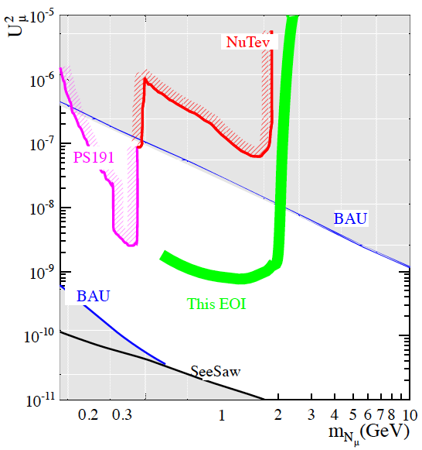
Expected event yield (cont.)
Assuming U_{μ}² = 10⁻⁷ (corresponding to the strongest experimental limit
currently for M_{N} ~ 1 GeV) and τ_{N} = 1.8×10⁻⁵ s
~12k fully reconstructed N → μ⁻π⁺ events are expected for M_{N} = 1 GeV
120 events for cosmologically favoured region: U_{μ}² = 10⁻⁸ & τ_{N} = 1.8×10⁻⁴s

Slide 19
Expected event yield (cont.)
ECAL will allow the reconstruction of decay modes with π⁰ such as
N → μ⁻ρ⁺ with ρ⁺ → π⁺π⁰, doubling the signal yield
Study of decay channels with electrons such as N → eπ
would further increase the signal yield and constrain U_{e}²
In summary, for M_{N} < 2 GeV the proposed experiment has
discovery potential for the cosmologically favoured region with
10⁻⁷ < U_{μ}² < a few × 10⁻⁹

Slide 20
Conclusion
The proposed experiment will search for NP in the largely unexplored
domain of new, very weakly interacting particles with masses below
the Fermi scale
Detector is based on existing technologies
Ongoing discussions of the beam lines with experts
The impact of HNL discovery on particle physics is difficult to
overestimate !
It could solve the most important shortcomings of the SM:
- The origin of the baryon asymmetry of the Universe
- The origin of neutrino mass
- The results of this experiment, together with cosmological
and astrophysical data, could be crucial to determine the
nature of Dark Matter
The proposed experiment perfectly complements the
searches for NP at the LHC

Slide 21
Being discussed with:
European Organization for Nuclear Research (CERN)
France: CEA Saclay, APC/LPNHE Universite Paris-Diderot
Italy: Instituto Nazionale di Fisica Nucleare (INFN)
Netherlands: National Institute for Subatomic Physics (NIKHEF, Amsterdam)
Poland: Henryk Niewodniczanski Institute of Nuclear Physics Polish Academy of Sciences (Kracow)
Russia: Institute for Nuclear Research of Russian Academy of Science (INR, Moscow),
Institute for Theoretical and Experimental Physics ((ITEP, Moscow),
Joint Institute for Nuclear Research (JINR, Dubna)
Sweden: Stockholm University,
Uppsala University
Switzerland: Ecole Polytechnique Federale de Lausanne (EPFL),
University of Zurich,
University of Geneva
UK: University of Oxford,
University of Liverpool,
Imperial College London,
University of Warwick

Slide 22
BACK - UP

Slide 23
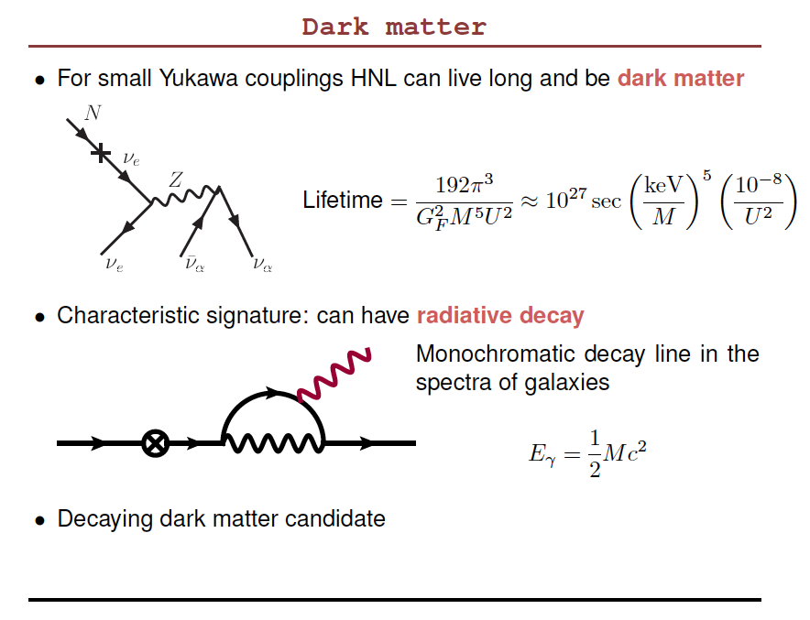

Slide 24
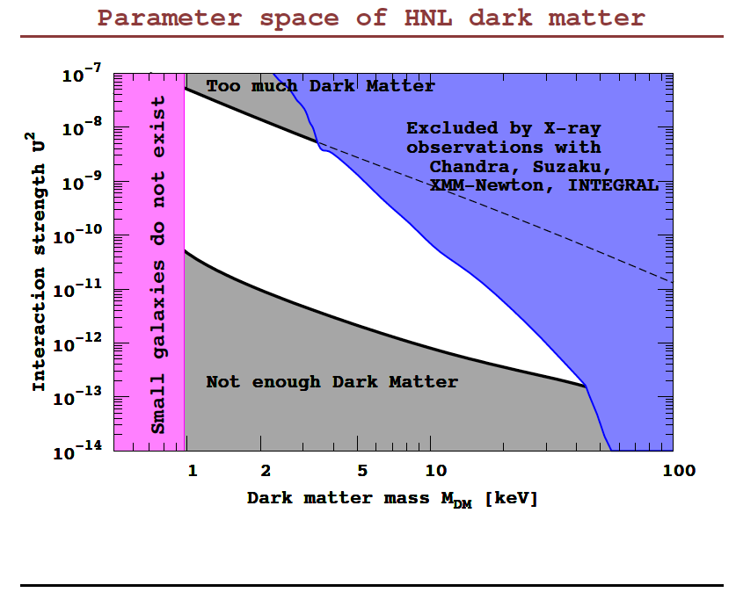

Slide 25
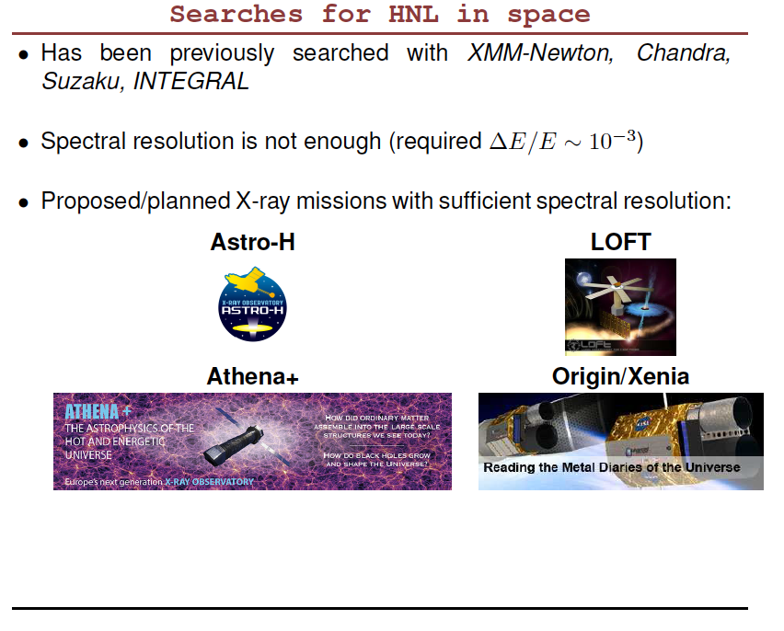

Slide 26
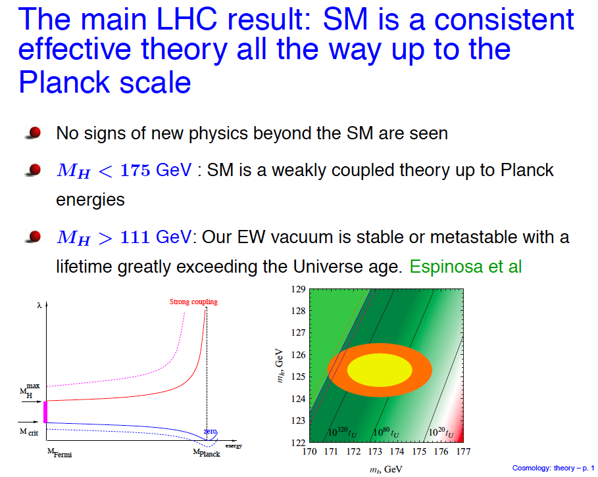

Slide 27
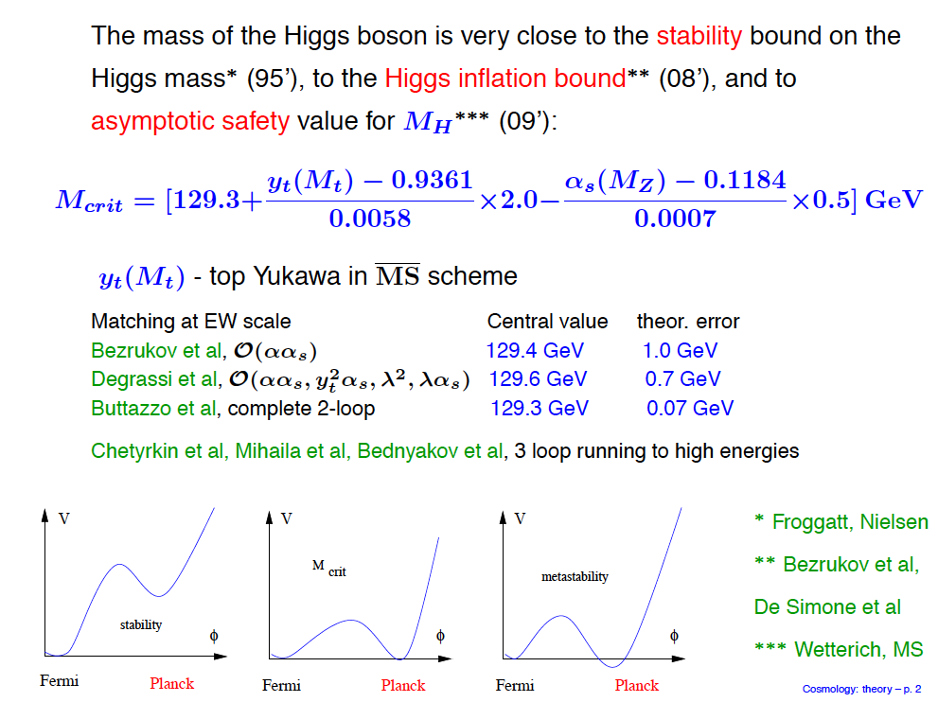

Slide 28
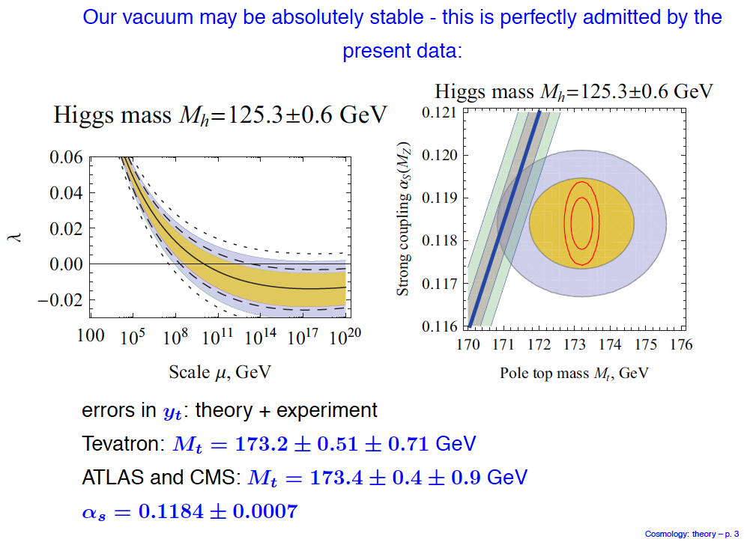

Slide 29
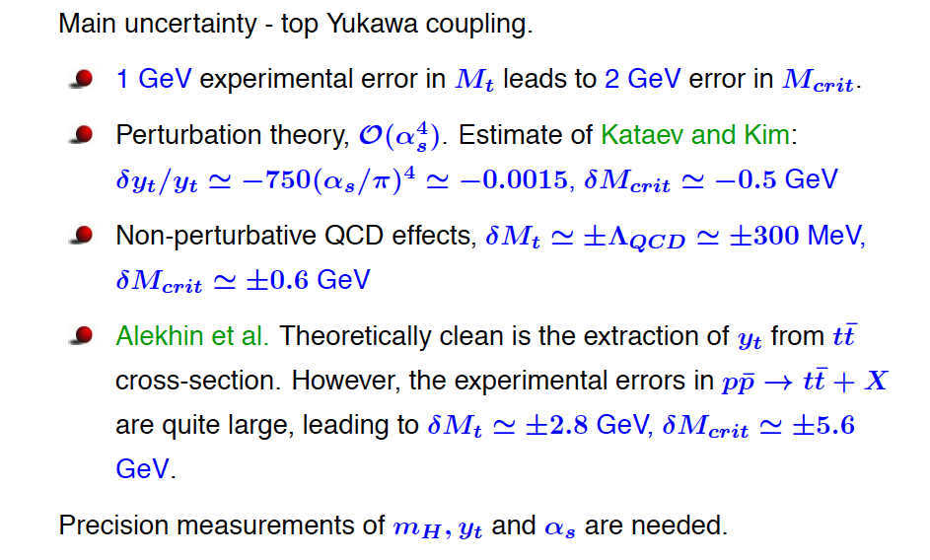

Slide 30
