Slide 1
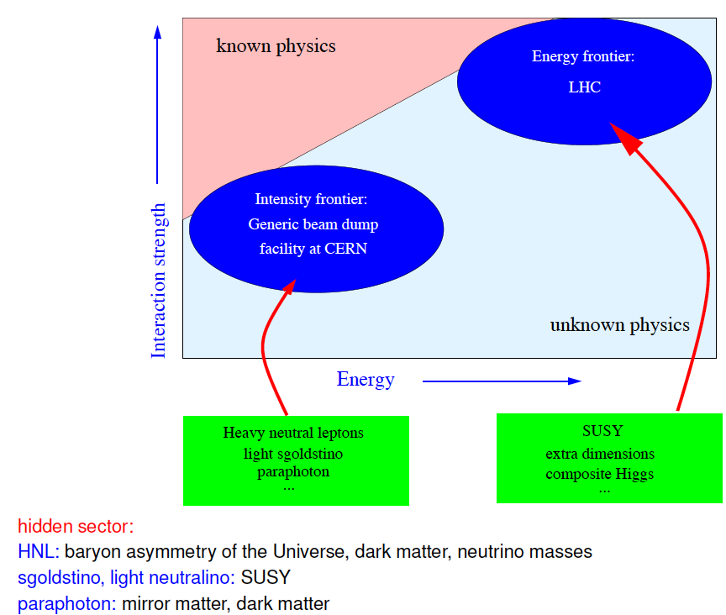

Slide 2
Primary Beam
Experimental sensitivity based on 2x10²⁰ protons on target, that is 5 years of equivalent CNGS operation
→ Basic experimental requirements
Maximum production of D mesons at an energy of ~400 GeV
Energy is driven by optimization between D cross-section, acceptance from boost, and amount of shield to range out muon flux.
6s/7.2s SPS cycles with preference for longest possible extraction spill to reduce detector occupancy
Easing requirements on detector and reconstruction
Minimal beam induced background in terms of neutrinos and muons
Use of a heavy target material (tungsten) to stop pions and kaons
HNL production angles relaxes significantly the beam parameters (collimation and alignment)
Beam delivery line consisting mainly of drift space and dilution to ease tungsten target design
Based on these requirements, the proponents have investigated a realistic NA option in close contact with beam, target, radiology, and infrastructure experts
SPS extraction in SPS-LSS2
Key study concerns optimal extraction type
Beam splitting/switch at the top of SPS-NA transfer line (TT20)
Key study concerns the possibility of a combined splitter for COMPASS and the EOI-010 experiment transfer line
A compact target bunker
Limited volume by the use of the hadron stopper closing the entrance to the muon shield tunnel
Wide tungsten target head
Key study concerns the solid tungsten target design with heat extraction and mechanical stress
60 m tunnel housing optimised combination of passive/active muon shield
A significant fraction of studies performed for neutrino facilities are directly beneficial to the current proposal (extraction, TT20 reuse, transfer line, target station, civil engineering and radiological aspects)
Time scale assumes start of operation as soon as SPS is delivering beam in LS2.

Slide 3
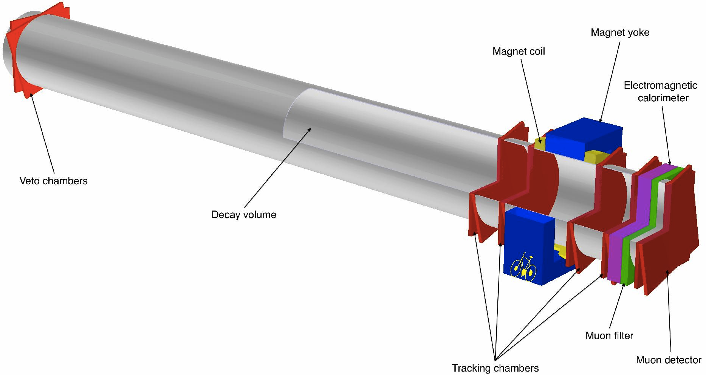
Detector concept
(based on existing technologies)
Reconstruction of signal decays in the final states: μ⁻π⁺, μ−ρ⁺ & e⁻ π⁺
Requires long decay volume, magnetic spectrometer, muon detector
and electromagnetic calorimeter in large experimental hall
HNL
π⁺
Long vacuum vessel, 5 m diameter, 50 m length
Two detector elements to double acceptance
Total required space is 2×50×20 m³
μ⁻
3

